Slide 1
Learning Python From Home
Becoming the Next-Gen Equity Analyst
Investment Research
May 2020

Slide 2
Table of Contents
Programming: A High-Demand Skill
Python: General Purpose, High-Level Language
Python: Scripting, Data Science, and Web Development
Python: Learning Flowchart
Python: Frequent Practice is Crucial
Python: Choosing Your Learning Style
Python IDEs: ‘MS Office’ for Python
Python: Limitations
Testimonials from Colleagues
Why do we need to learn programming
Colab sessions

Slide 3
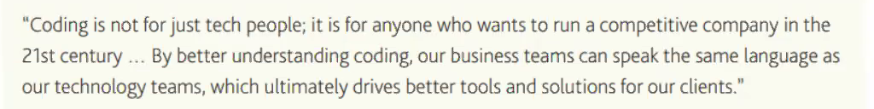
Programming: A High-Demand Skill
Programming is the implementation of logic to facilitate specified computing functionality
Increasingly demanded skill by employers. Learning it will help;
Understand where and how we can apply it
Understand its limitations
Consequences of programming illiteracy?
Underestimate implementation time
Overestimate scope
Underestimate required skill levels
Learn even basic programming will help you have more informed conversation with software devs, algorithm designers, etc.
Source: Head of J.P. Morgan asset management
Notes:
Programming jobs growing 12% >market – Burning Glass tech, GS tech inters: 72% want to learn python vs. 28% Mandarin

Slide 4
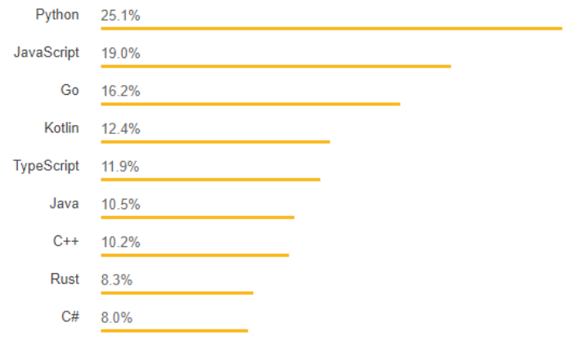
Python: General Purpose, High-Level Language
Python is a general purpose, high-level language
Core advantages include:
Ease of learning/readable code
Wide developer and support community
Robust standard libraries
Multiple open source frameworks
Compatible across multiple platforms
Source: https://stxnext.com
Notes:
https://medium.com/@mindfiresolutions.usa/python-7-important-reasons-why-you-should-use-python-5801a98a0d0b
https://stxnext.com/python-vs-other-programming-languages/

Slide 5
Python: Scripting, Data Science, and Web Development
Scripting
Web-scraping
Rules based automation
Data Science
Visualizations led analysis
Statistical analysis, Machine Learning, and Artificial Intelligence
Web Development
Building APIs using web frameworks
Building dashboards
Of course there is much more, but this is a decent starting point

Slide 6
Python: Learning Flowchart
Envision what you’d like to achieve
Scraping data sources, automate templates, etc?
Learn the capabilities of your language
Understand basics e.g. tutorials, YouTube
What are variables, libraries, loops, etc
e.g. https://www.tutorialspoint.com
Install an Integrated Development Environment (IDE) - copy pasting code form the tutorials
Code from Courses, Classes, Books, Google, etc
Tinker around with parameters on your copy/pasted code. Get a feel for formatting and parameters
Understand types of errors, debug
Identify more specific areas of interest and begin more complex projects
E.g. Data cleaning, web scraping
Rinse and repeat. Record and version your work
Version control and testing

Slide 7
Python: Choosing Your Learning Style
Multiple methods of learning including, each with its benefits and compromises
Method | Advantages | Disadvantages | Who does it suit?
Courses | - Structured - Some flexibility - Breadth of choice - Automated feedback | - Can be restrictively narrow - Can get bored/not enticing to explorers | - Great if smaller attention span - Can help facilitate some discipline…
Classes (incl. degrees, online) | - Structured - Reinforces dedication - Broad depth | - Requires physical effort - Not flexible - Costly | - Ideal if you lack discipline
Books | - Structured - Easy to use/can be used anywhere | - Can be restrictively narrow - Not flexible - No feedback - Practice still requires a PC | - Ideal for when starting out - Supplementary input only
Goal-based self learning | - Can rapidly accomplish specific tasks - Highly explorative technique - Maximum flexibility | - Highly unstructured - Easy to loose focus/track - No feedback | - Need to set succinct goals - Best suited for motivated individuals with a specific focus
In practice, we employ a mix of different techniques from above, but have usually one dominant trait

Slide 8
Python: Frequent Practice is Crucial
Practice frequently
Organize
Concentrate on one concept
Organize your research
Comment your code and save modules/versions with descriptions
Collaborate with fellow colleagues learning as well
Build your own project

Slide 9
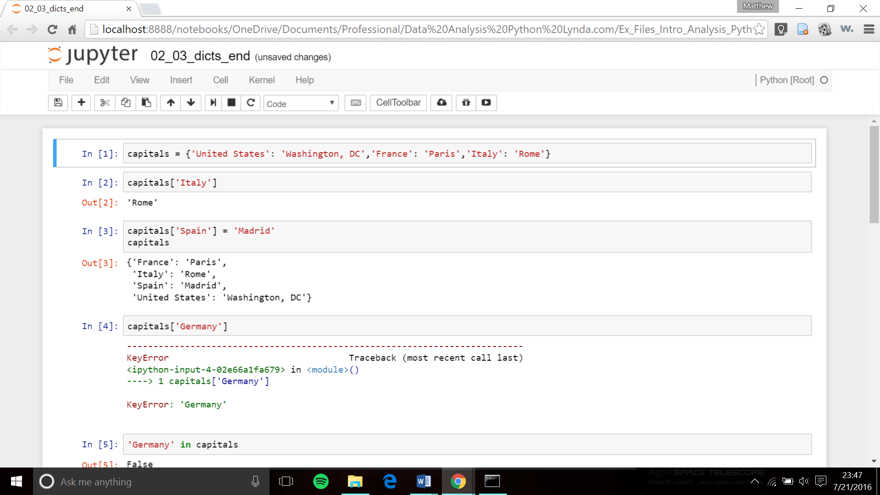
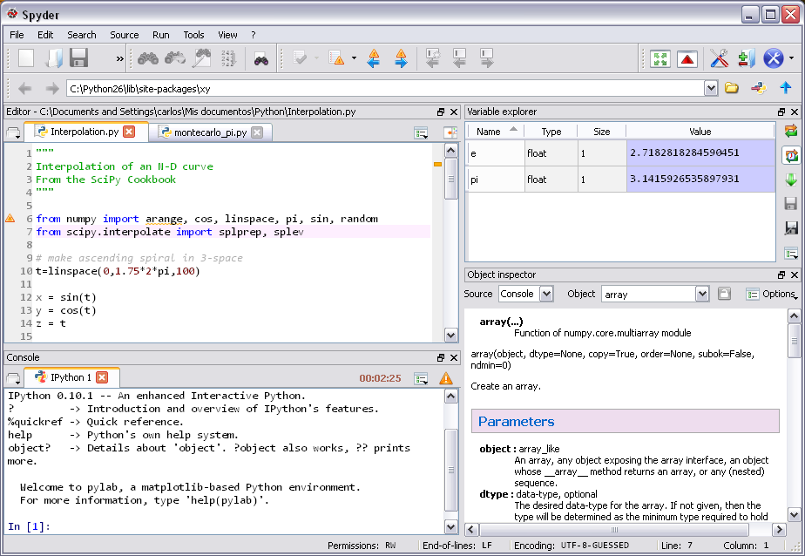
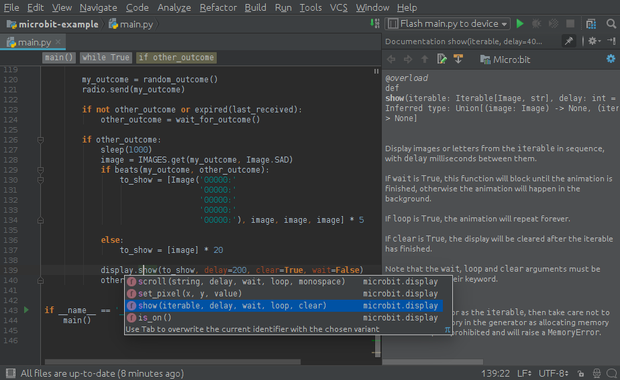
Python IDEs: ‘MS Office’ for Python
Spyder, PyCharm, Jupyter, are Integrated Developments Environment
Used to write, evaluate, comment, and debug code
Jupyter
Walkthrough
Spyder
PyCharm

Slide 10
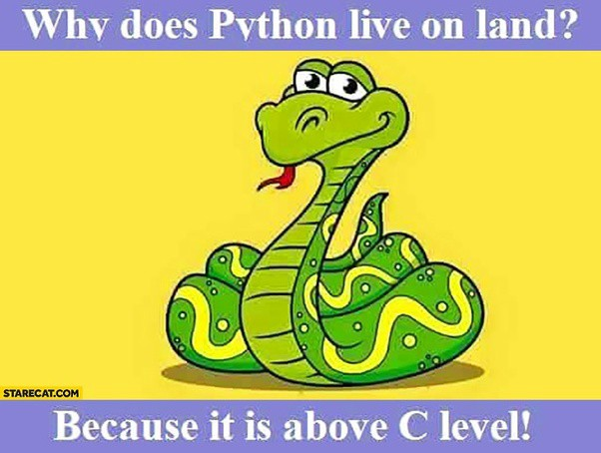
Python: Limitations
Not a replacement for Excel, or Word or any Office Suite Application
For simple charts Excel is much easier than Python
For computationally intensive applications (ML/AI) comparatively slower (e.g. vs. C++)

Slide 11
Testimony from Colleagues - Sasitha
“Coming from a finance background, python was the ideal choice because it is a relatively easier programming language to learn…
…Accessibility to a large number of free resources online…
…Readymade tools for current hot technologies like data science, machine learning, AI and robotics...
…Before you jump into learning, its worth asking why you want to learn it and what areas you are interested in...
- Preferred method of learning: YouTube, E-books, video lectures with Jupyter notebooks as assignments
- Starting material: Udemy Python Bootcamp, Edx, CS Dojo, IDE and learn the basics
- IDE: Spyder, I prefer this IDE because it allows you to see your variables clearly and much easier in terms of running and debugging scripts

Slide 12
Testimony from Colleagues - Randula
“Opportunity to learn from Acuity Python training course and realized its far easier to learn compare to other languages...”
“Apply the learnt Python to improve efficiency and quality of my day-to-day computer related work. I created main objectives and broke them into small problems until I could solve them by using Python basics..”
“I always got the answers, because support for Python is readily available in many places (eg, Github, Youtube, etc.), and learned something new every time.”
- Preferred method of learning: Recommend to learn basics through a structured course. Use Github, Youtube and other web source for ongoing learning.
- Starting material: Acuity Python training course, Udemy Python Bootcamp
- IDE: Spyder. It has lots of useful functions such as variable explorer, and easier to debug and execute the codes.

Slide 13
Gamika Seneviratne
Gamika.seneviratne@acuitykp.com
Devin
Randula

